Slide 1
CST2550 Software Engineering Management and Development coursework 1
Anikhil Patel M00861390

Slide 2
Introduction
My project is made for librarians to simply add members, issue and return books from these members, and see which books are borrowed by which member
The librarian logs into the system inputting their ID, name, address, email and salary. Then the librarian has the option to add a member issue and return books, display the books borrowed by a member and calculate the fine depending on the due date of the book borrowed.
The program has a simple and easy to understand UI for the librarian to be able to carry out these following tasks as easy as possible
Overview:
Design – Use cases
Approach – Implementation and Makefile
Test cases
Conclusion – Summary and Limitations

Slide 3
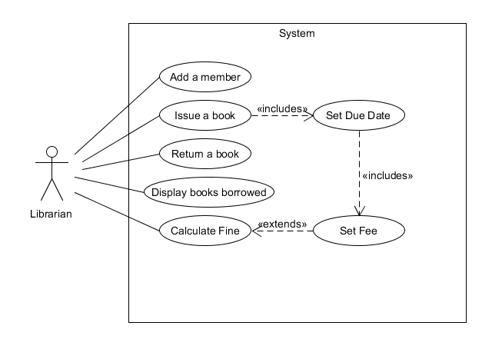
Use case Diagram

Slide 4
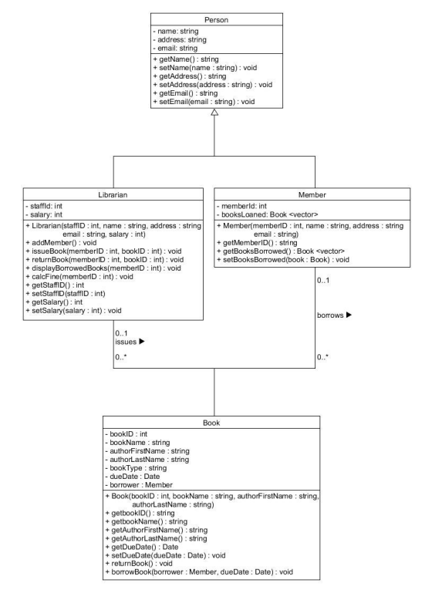
Uml Class diagram

Slide 5
Use case specifications
Use case: Add a Member
ID: 1
Brief Description: Add a member to the program
Primary actors: Librarian
Secondary actors: None
Preconditions: Librarian is Logged in to the program
Main flow: 1. Librarian enters Member Name 2. Librarian enters Member Address 3. Librarian enters Member email 4. System creates and stores Member details
Postconditions: Member is successfully added
Alternate flows: None
Use case: Issue a book
ID: 2
Brief Description: Book is issued to the Member
Primary actors: Librarian
Secondary actors: None
Preconditions: Librarian is logged in to the program and a member has been created
Main flow: 1. Librarian enters Member ID 2. Librarian enters Book ID 3. System issues the Book with the Book ID entered to the Member ID
Postconditions: Book is issued to the corresponding Member
Alternate flows: None

Slide 6
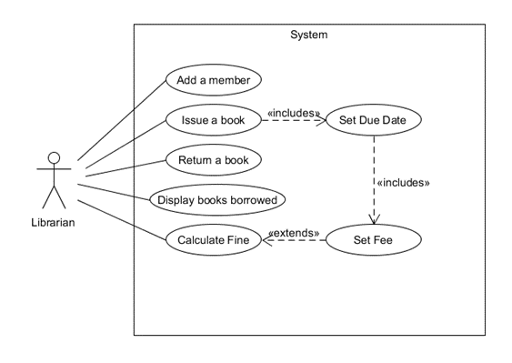
Use cases Specifications continued
Use case: Return a book
ID: 3
Brief Description: Return an issued book from a member
Primary actors: Librarian
Secondary actors: None
Preconditions: Librarian is logged in, a member is created, and a book has been issued to the Member
Main flow: 1. Librarian enters Member ID 2. Librarian enters Book ID of book to be returned 3. System returns the book borrowed by the Member
Postconditions: Book is returned and can be issued again
Alternate flows: None
Use case: Display books borrowed
ID: 4
Brief Description: Show all the books borrowed by a Member
Primary actors: Librarian
Secondary actors: None
Preconditions: Librarian is logged in, a Member has been created and been issued a book
Main flow: 1. Librarian enters Member ID 2. System checks and displays all books borrowed by the given Member ID
Postconditions: Books borrowed by the Member ID given are displayed to the Librarian
Alternate flows: None
Use case: Calculate Fine
ID: 5
Brief Description: Calculate the fine depending on the due date of the borrowed book
Primary actors: Librarian
Secondary actors: None
Preconditions: Librarian is logged in, a Member is added, and the Member has borrowed a book, the book is overdue by 1 day
Main flow: 1. Librarian enters the Member ID 2. System checks according to the date the book was issued if there is a fine 3. System issues a fine for the number of days late the book is £1 per late day
Postconditions: Displays the fine the Member is dues depending on how many days past the due date is
Alternate flows: None

Slide 7
Approach and Implementation
Given the UML Class Diagram, I used this to help implement the design into a working software
I declared the classes and the functions that would be needed in separate C++ header (.h) files
The .cpp files, corresponding to the .h files, contained the implementation of these functions and the uses of these declared classes
It helped to develop an understandable project and I made use of actual time within C++ using <ctime>

Slide 8
Approach and Implementation
Makefile:
The Makefile was used to construct and compile all the .cpp files and .h files together into an executable file
The compiler was set to g++ and the compiler flags –g -Wall -Wextra –Wpedantic for enabling additional warning messages
The Makefile was used to make an executable file to run the program and the executable file relied on several object files
For each source file Librarian.cpp, Member.cpp, Book.cpp, Date.cpp, main.cpp, there is a compilation rule that specifies how to compile it into an object file
The Makefile also defines what make clean does in this case it removes the .o (objects created for the executable) and the executable itself
The ‘make’ command itself compiles and links all the .cpp files together to get an executable program

Slide 9
Testing approach
Unit testing:
The approach I used to test the system is unit testing as I used it to test classes and functions in the program
I conducted unit tests for individual classes such as Librarian, Member, Book, and Date, this is to make sure that they worked correctly
Details of Test Cases:
Test Case: Librarian Class:
Section: Checking if a member can be added
Section: Issue a valid book to the member
Section: Return the valid book from the member
Test Case: Member Class:
Section: Returning a book from the member
Test Case: Book Class:
Section: Borrowing the defined book
Section: Returning the defined book
Test Case: Date Class:
Section: Printing the date that is defined

Slide 10
Testing Approach Continued
Test Case: Add Member Function: Section: Adding a member and checking to see if the name was added Section: Add multiple members and check if the size of the members vector is 2
Test Case: Issue book Function: Section: Issuing a valid book to a member Section: Issuing an already borrowed book Section: Issuing a book with invalid member ID Section: Issuing a book with invalid book ID
Test Case: Return book Function: Section: Return a valid book Section: Returning an already returned book
Test Case: Display Borrowed Books Function: Section: Displaying borrowed books for a valid member Section: Displaying borrowed books for an invalid member
Test Case: Calculate Fine Function: Section: Calculating fine for a member with overdue books Section: Calculating fine for a member with no overdue books Section: Calculating fine for an invalid member

Slide 11
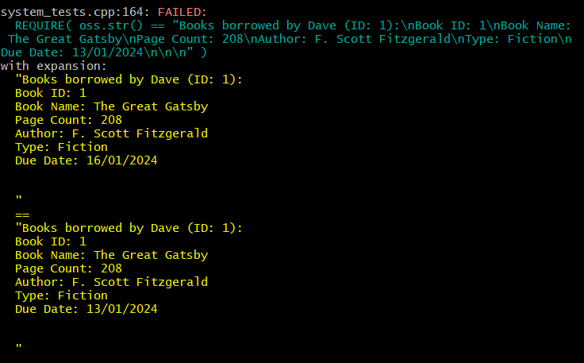
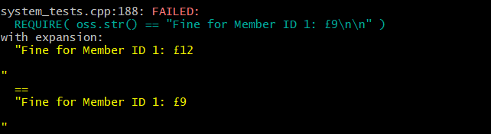
Testing Approach Continued
Catch2 Tests
2 Tests will always fail this as they are dependent on the date:
If I change the date to the correct date they do pass successfully

Slide 12
Conclusion
The project successfully works for the librarian to add members to issue books, see the books that the members are borrowing and return the borrowed books. The librarian is also successfully able to see the fine due for overdue books, however the only way I managed to test this is to manually change the date on my system to a few days into the future while the program is running.
Limitations:
There were many limitations to this project, the main limitation being time, if more time were allocated, perhaps the librarian login details would have been saved in a separate file for ease of use, same for the member details, the details could have been saved elsewhere so that its easier instead of adding a member each time the program is run
I also had issues with calculating the fine, the function worked, but I had to change the date on my computer to check while the program was still running
In future projects, I would approach them in a similar way, designing and creating UML class diagram to start with and then implement them
I would change the testing approach and include more testing approaches to ensure the project is tested more, but as time was a limitation on this project, I could only test it with unit testing

